Slide 1
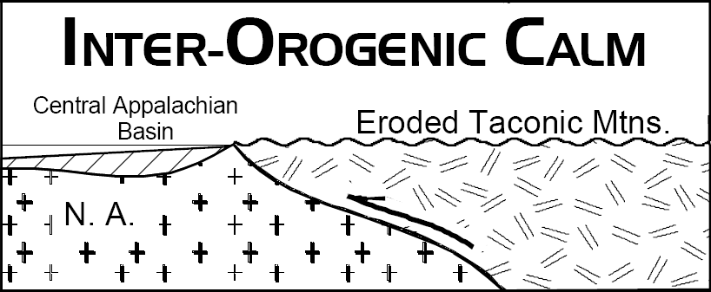
Notes:
After the Taconic Mountains eroded and the Tuscarora spread across the area, a period of orogenic calm followed. Deposition was confined to the broad Central Appalachian Basin (CAB)…

Slide 2
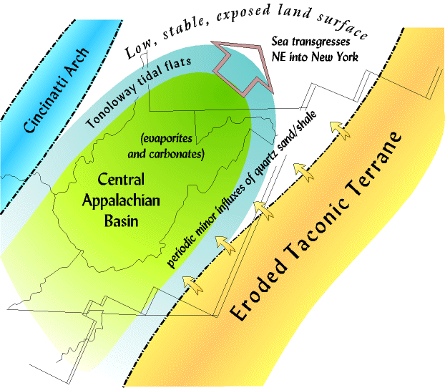
Notes:
… which lay between the eroded Taconic Mountains to the east and an area of mild uplift, the Cincinnati Arch to the west. Except when sea level was high, the CAB was mostly a closed inlet, surrounded by low land areas, and isolated from the rest of the Tippecanoe sea except for a persistent connection to the Tippecanoe in the deep south that allowed the sea to flow in and out. The climate was hot and dry, so mostly carbonate sediments accumulated in the CAB in the late Silurian, although at the peak of the heat and dryness, hundreds of feet of evaporites also accumulated because of the high evaporation rates.

Slide 3
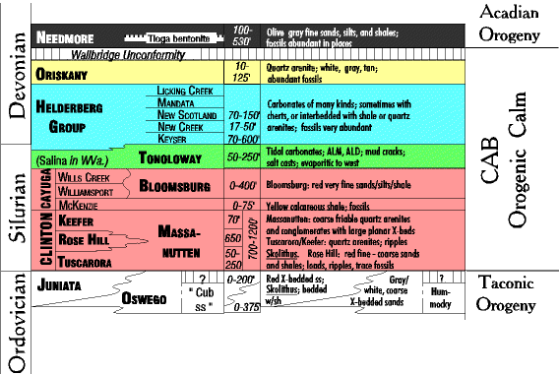
Mature, thin & discontinuous
Notes:
During orogenic intervals great thicknesses of immature sediment are spread out across vast areas. But during non-orogenic intervals like that which followed the Taconic, most of the formations deposited are thin and their geographic distribution tends to be patchy, limited, and rapid facies changes are common.

Slide 4
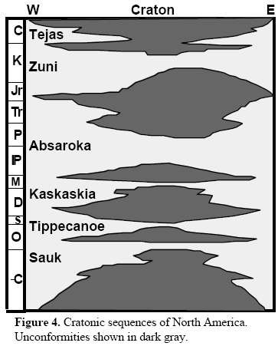
Notes:
Like the Sauk sea had done before it, the Tippecanoe sea regressed as orogeny was beginning to stir, but this time in the Rheic Ocean …

Slide 5
Orogenic Calm in the Central Appalachian Basin Silurian and Early Devonian; 435 - 370 mya
Approaching Acadian Orogeny
Notes:
… whose oceanic crust was subducting beneath the Acadian island arc. The collision of the Avalon terrane will be felt all along the Atlantic margin, ….

Slide 6
Great Smokey
Shenandoah
Acadia
Closing
Collision Orogeny
Peneplanation
Rifting
DCM Sedimentation
Subduction Orogeny
+/- Terrane Accretion
Opening
Closing
Notes:
… but of our three Appalachian National Parks, only Acadia will boast exposures of the actual Avalon terrane.

Slide 7
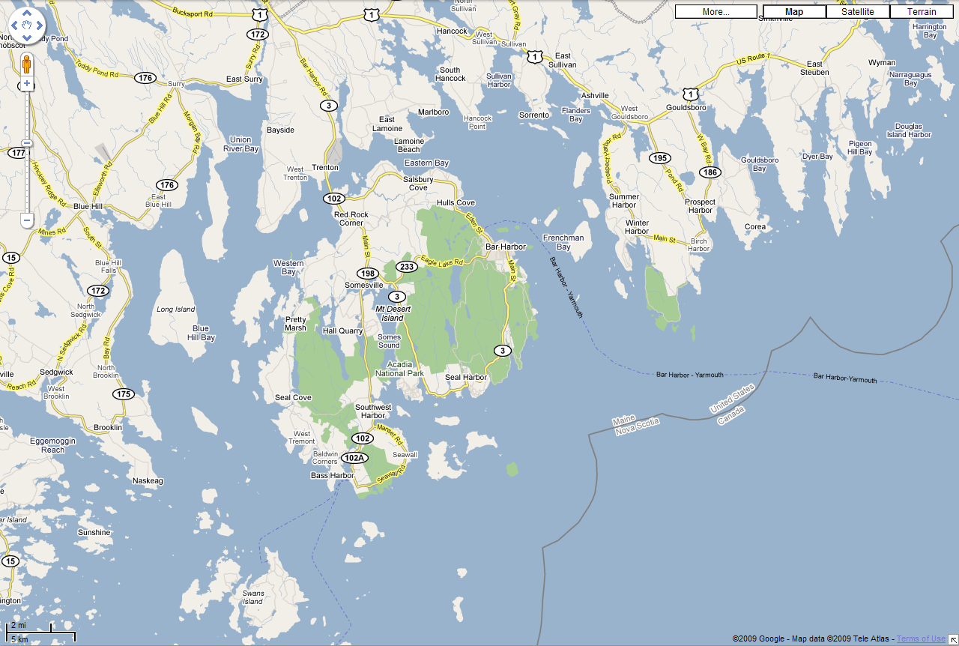
Schoodic Peninsula
Mt. Desert Island
Notes:
Located along the rugged central coast of Maine, the bulk of Acadia National Park lies on Mount Desert Island, but a portion also falls on the Schoodic Peninsula and a few small islands nearby.

Slide 8
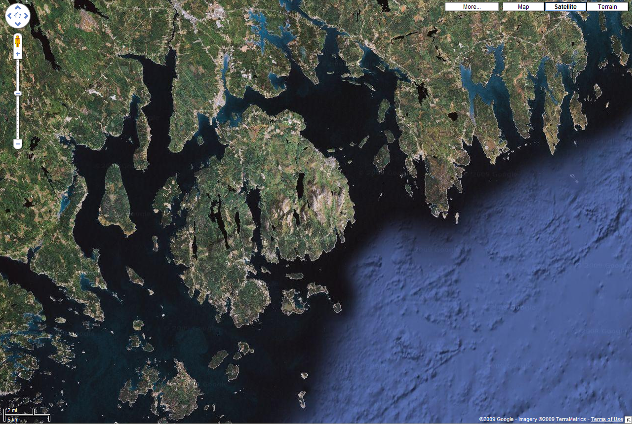
Notes:
Acadia National Park is not only special for containing a well preserved terrane, it also shows off of some of the best glacial and coastal geology along the entire east coast of North America. Since we are following a chronological sequence here, we’ll look at the glacial and coastal features later.

Slide 9
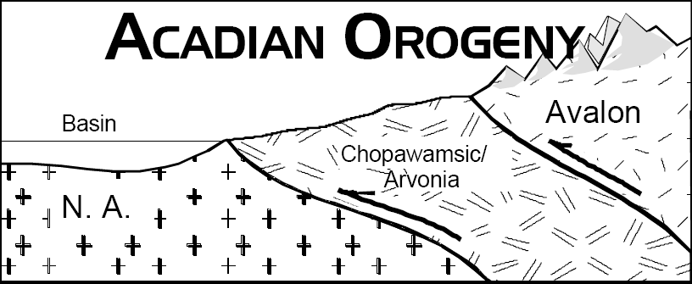
Notes:
For now let’s focus on the Acadian Orogeny. Like the Taconic orogeny, the Acadian will ramp a terrane up and over the North American foreland, create a major mountain range and yet another foreland basin…

Slide 10
The Devonian Acadian Orogeny And Catskill Clastic Wedge Middle to Late Devonian; 380 - 350 mya
Catskill Foreland Basin
Notes:
… known as the Catskill foreland basin. The Acadian will be the last “soft” collision before the “hard” collision which will smash Africa into North America and form Pangaea.

Slide 11
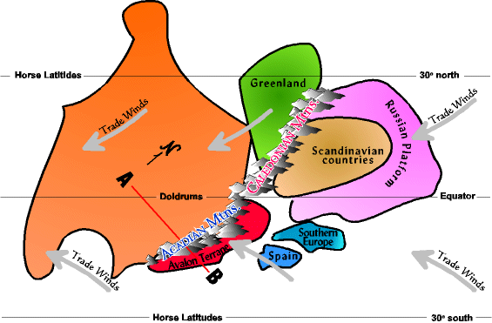
Notes:
The Acadian occurred just slightly after Canada collided with Greenland and Scandinavia – a collision which formed the Caledonian Mountains in Great Briton, Greenland and Scandinavia. The Avalon terrane collided to the south of the Caledonians, but the collision was a glancing blow rather than head on.

Slide 12
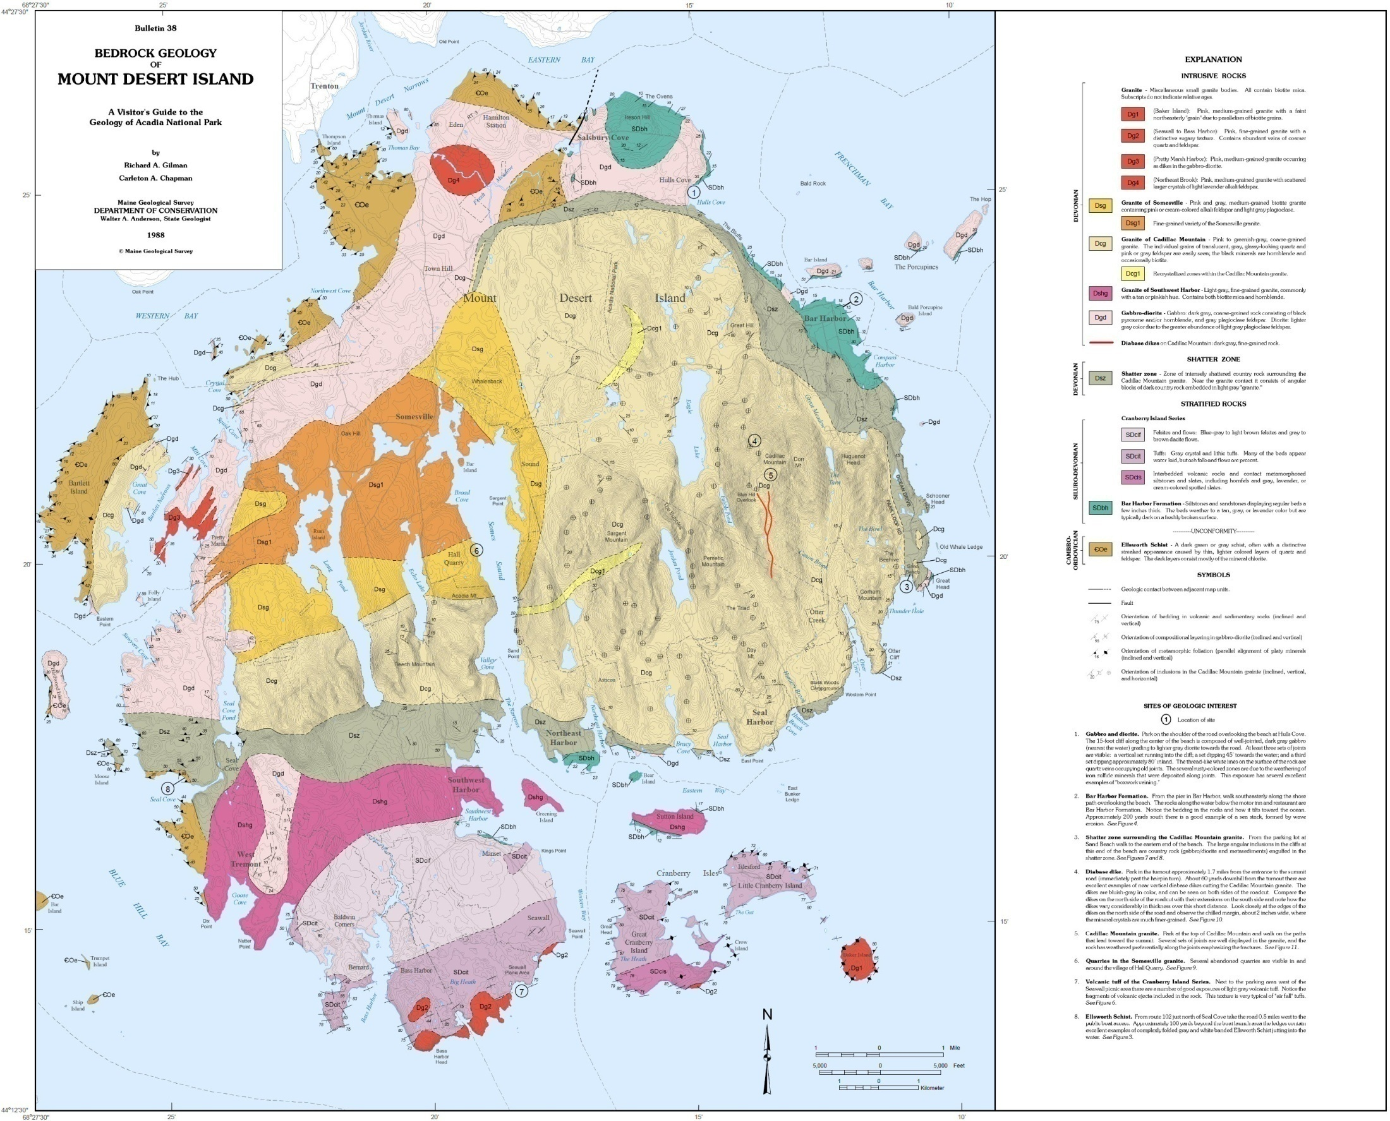
Notes:
Rocks of the Avalon terrain occur throughout Acadia National Park and they have a crudely concentric arrangement with generally younger rocks towards the center of the island. In very general terms, this arrangement formed as plutons diapirically intruded a sequence of older rocks.

Slide 13
Notes:
To visualize what happened, think about the oldest rocks as being like a pizza.

Slide 14
Notes:
Now push your fist up from underneath such that the pizza domes upward, …

Slide 15
Notes:
… and then penetrates the pizza. The older rocks (represented by the pizza), end up surrounding the younger pluton (represented by your fist).

Slide 16
OLDER
OLDER
YOUNG
YOUNGER
YOUNGEST
YOUNG
OLDER
Notes:
Although more than one pluton intruded here, the pattern is basically the same.

Slide 17
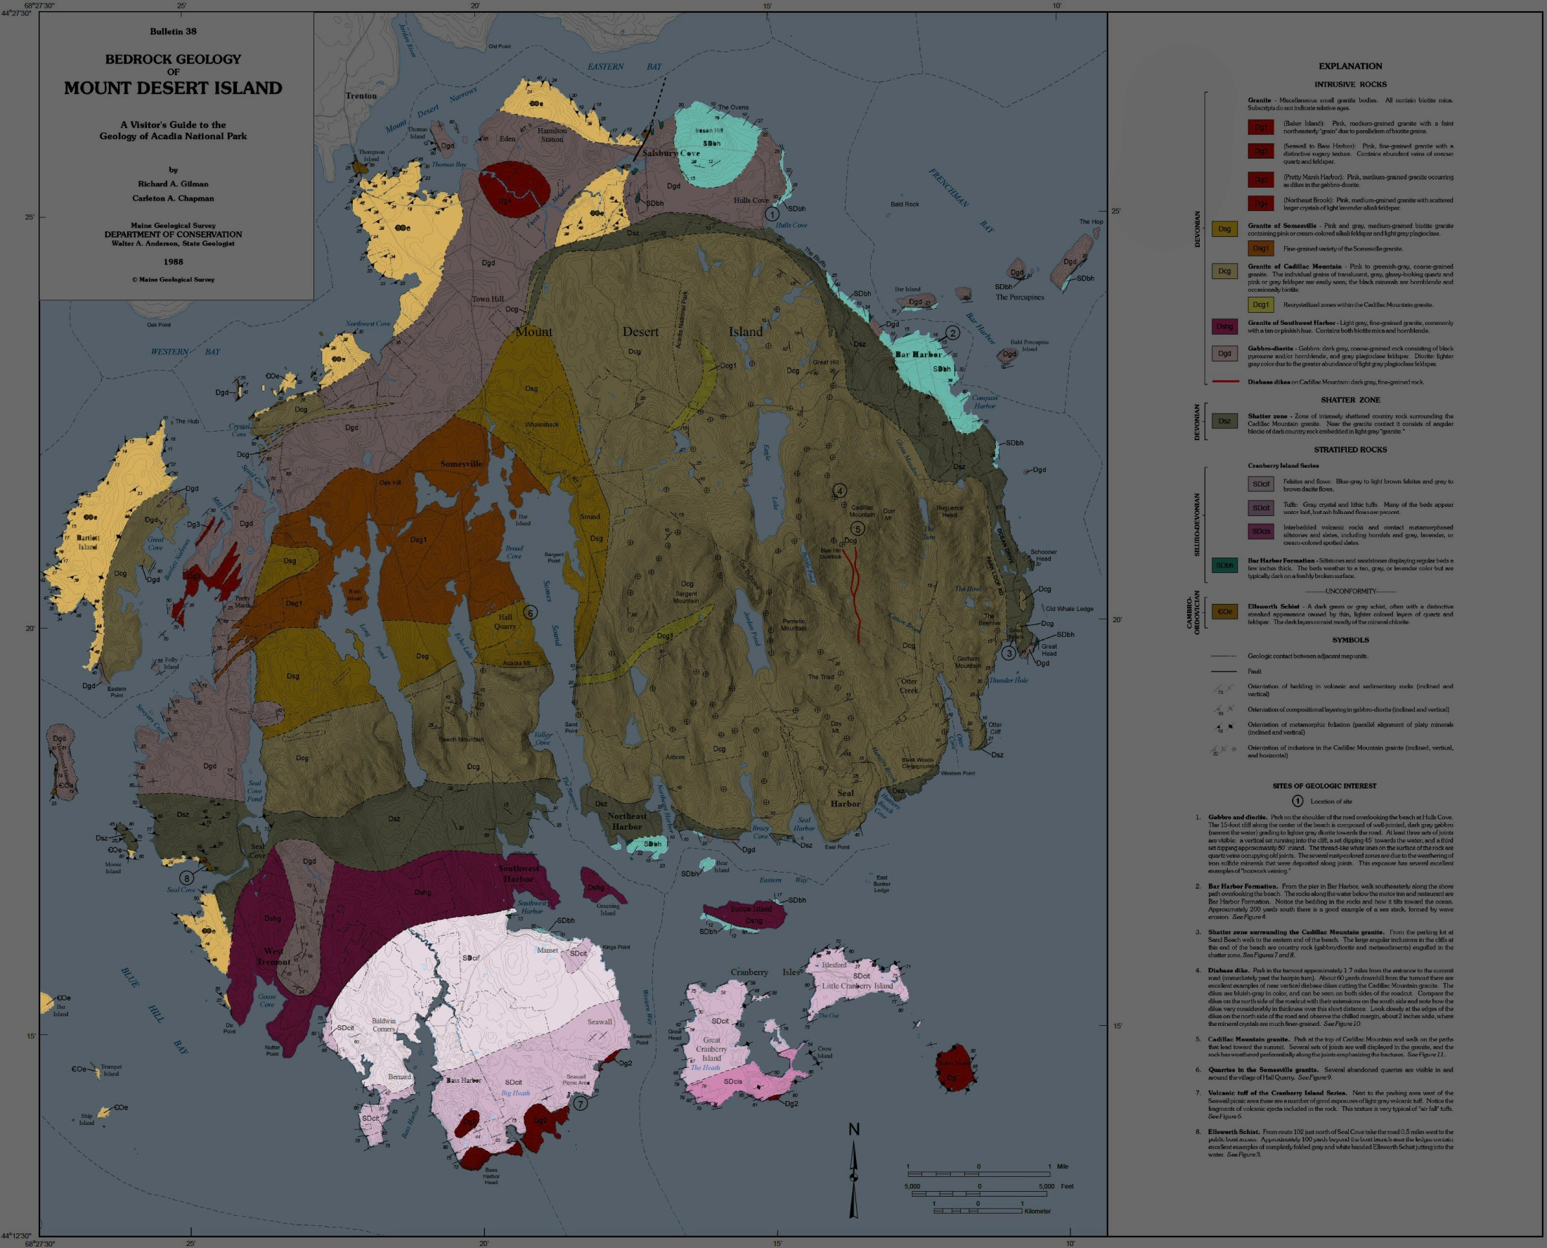
Notes:
Encircling the island are the oldest rocks. They belong to three main groups, all of which are stratified. From oldest to youngest they include …

Slide 18
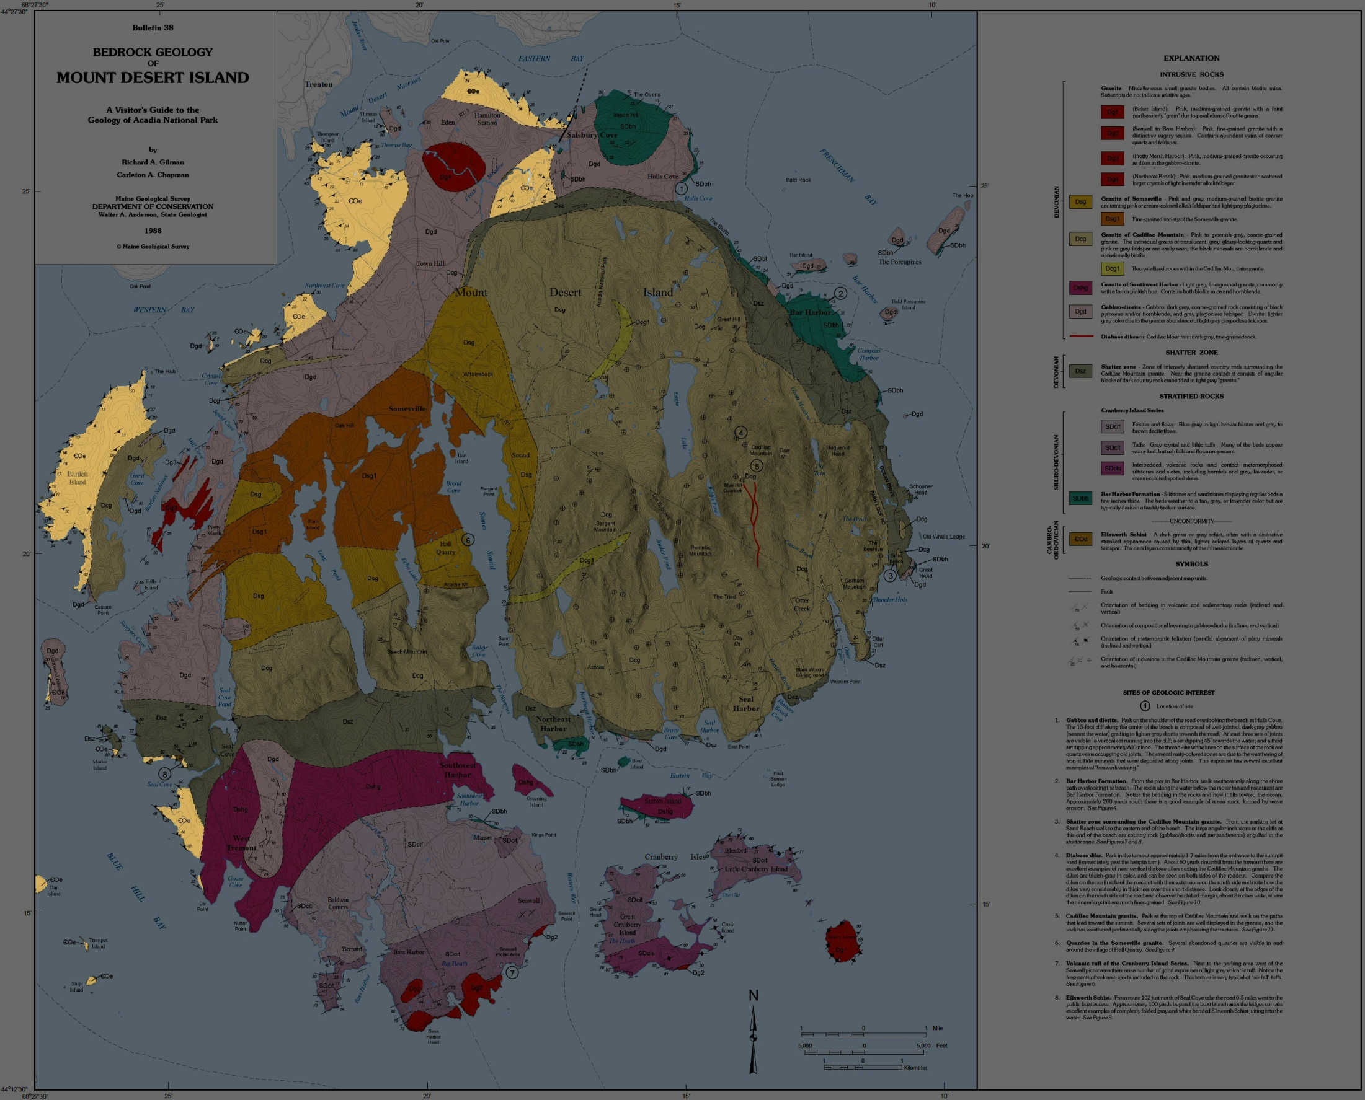
Notes:
… the Ellsworth Schist …

Slide 19
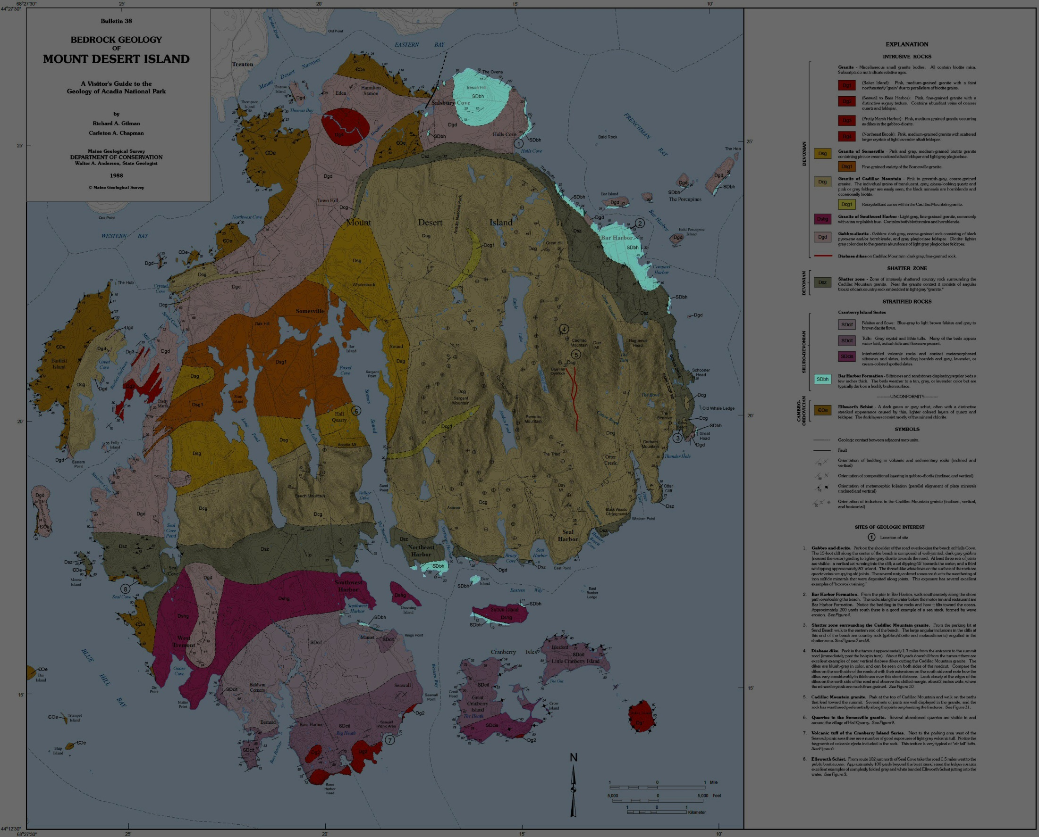
Notes:
… Bar Harbor Formation …

Slide 20
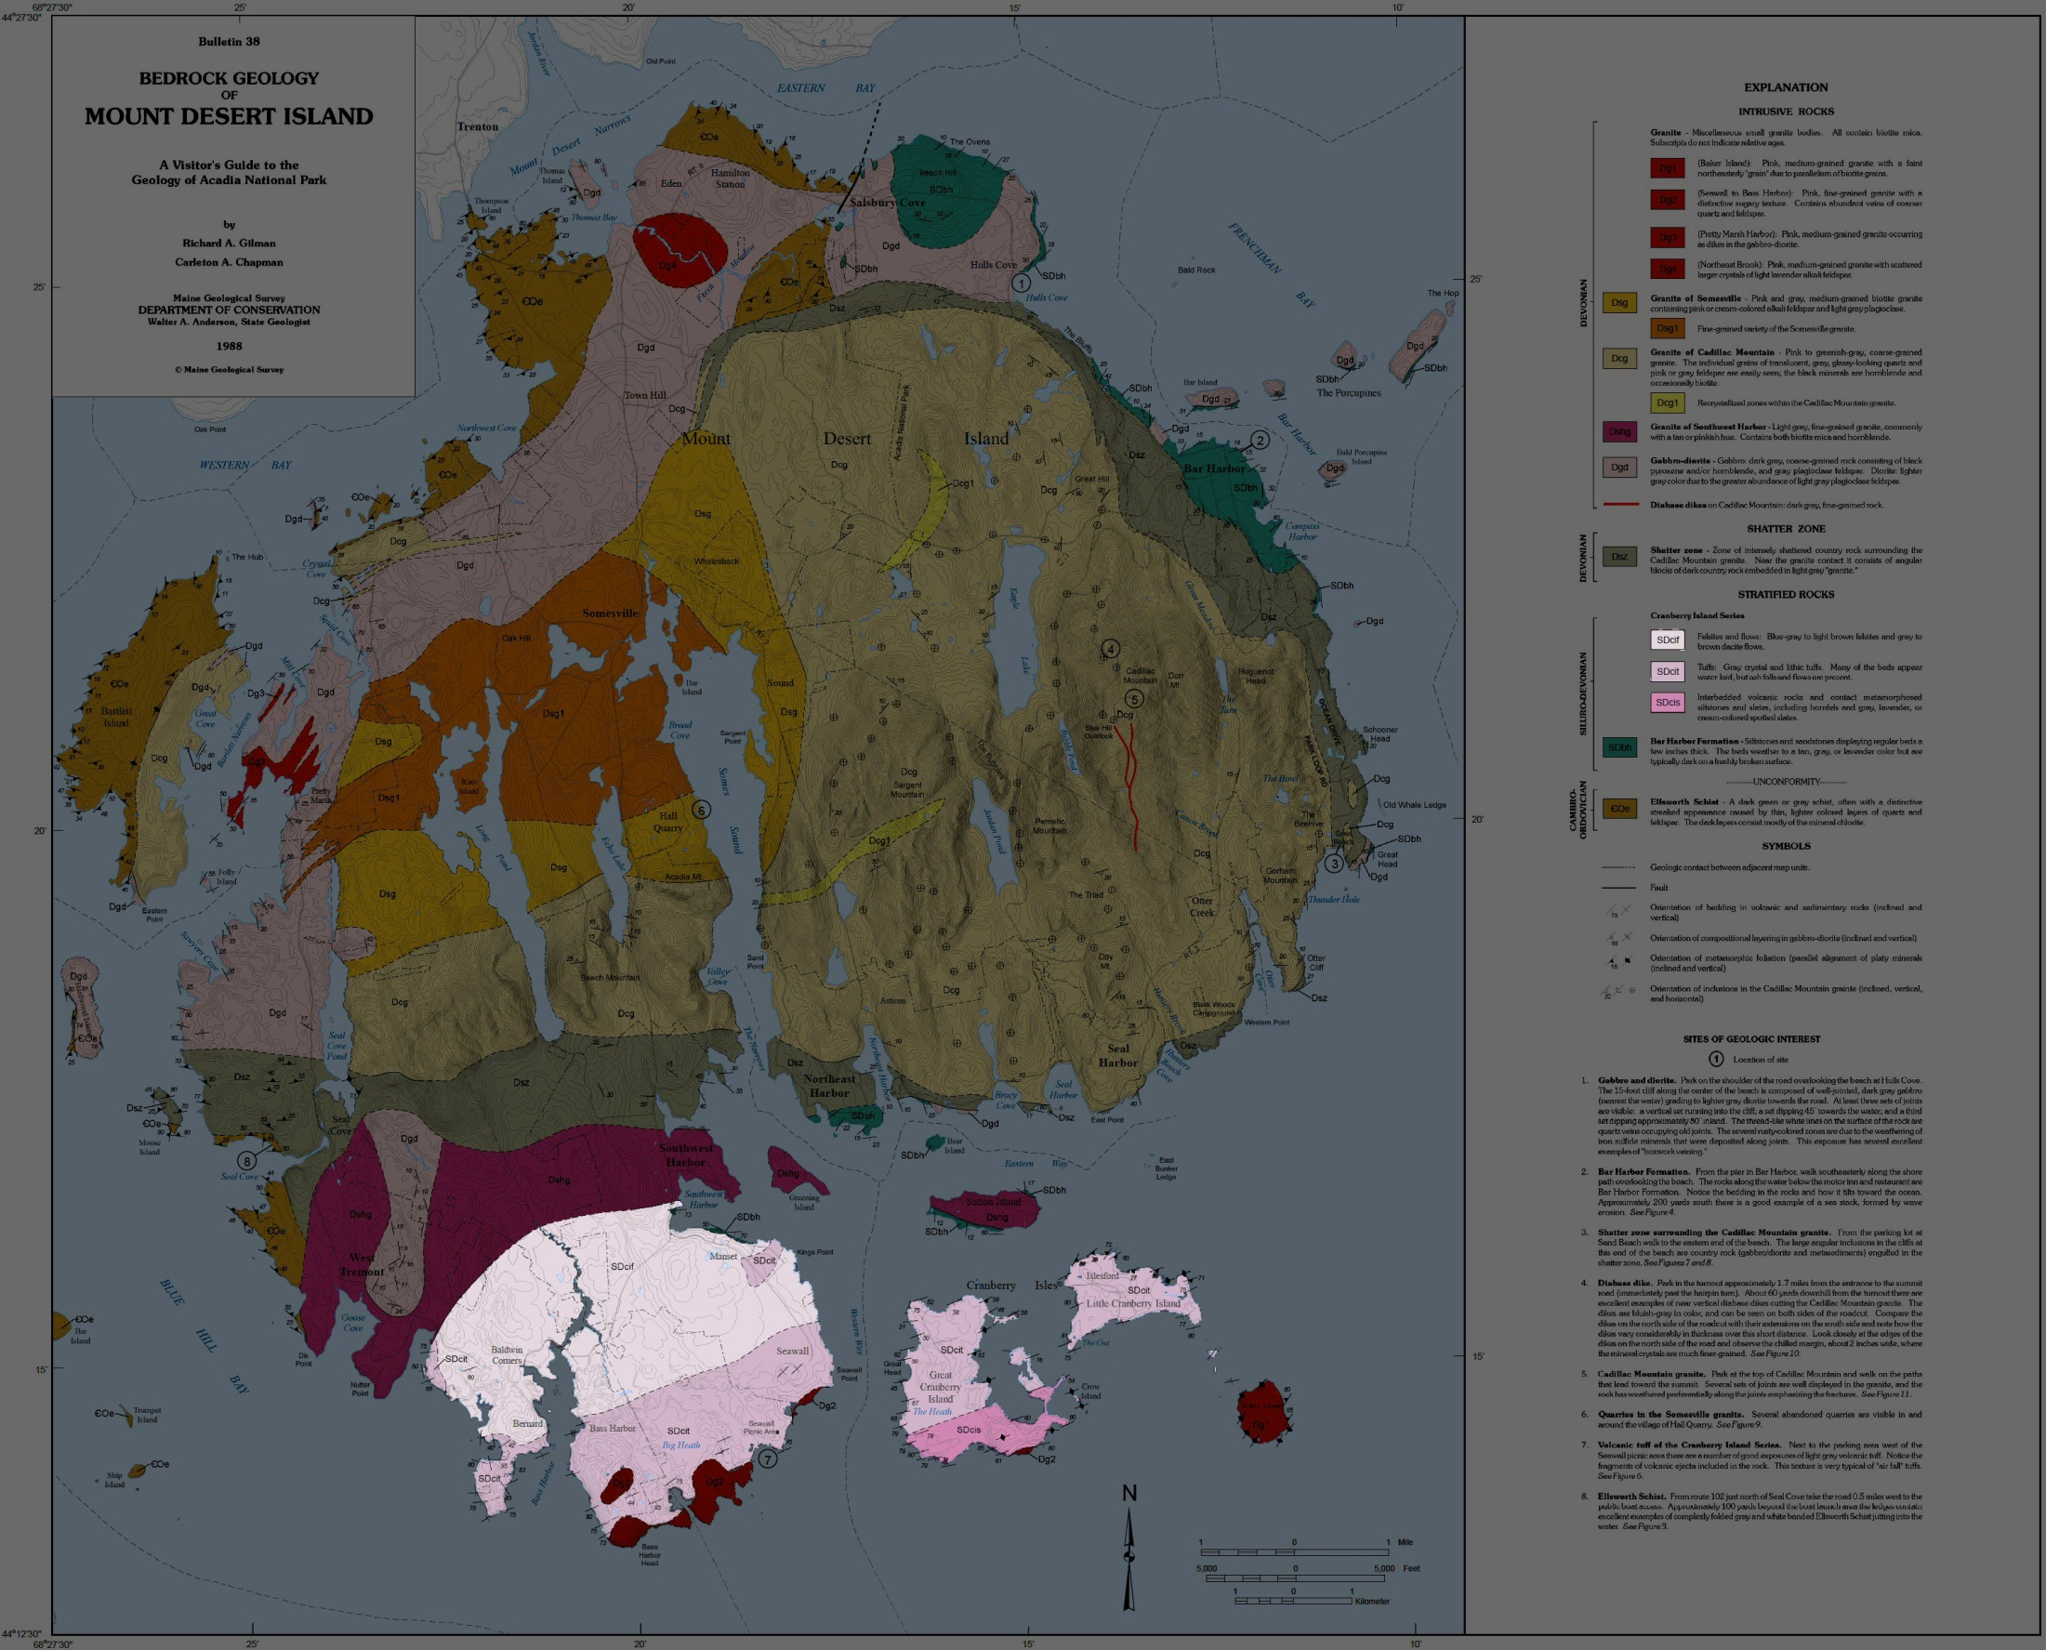
Notes:
… and the Cranberry Island Series.

Slide 21
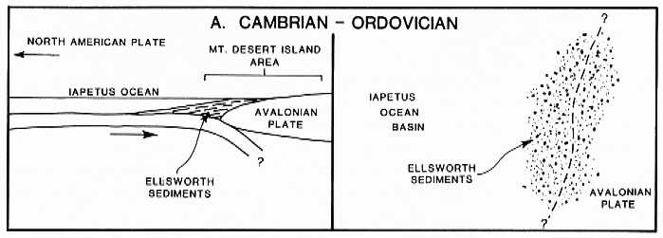
Notes:
The Ellsworth Schist began as marine mud and ash deposited during the Cambrian on the western margin of the Avalonian plate.

Slide 22
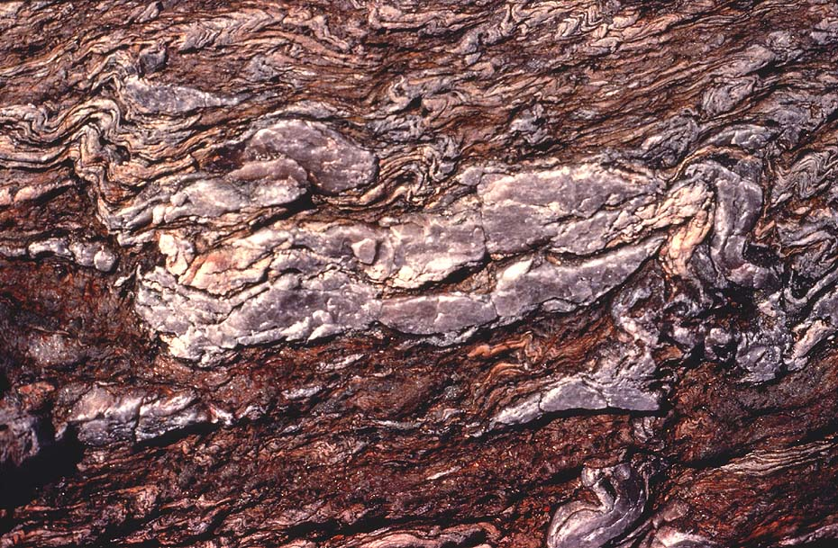
Ellsworth Schist
Notes:
These sediments where metamorphosed into the contorted folds shown here during the late Cambrian to Early Ordovician – perhaps by the amalgamation of Avalonia into a larger terrane or perhaps by collisional events that were precursors to the Acadian orogeny. The truth is that we just don’t know a lot about Avalonia.

Slide 23
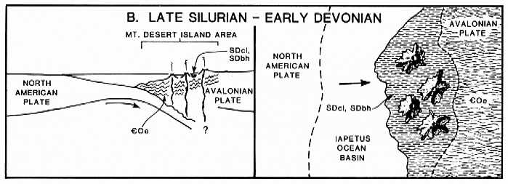
Notes:
At any rate, uplift and erosion must have followed the metamorphism of the Ellsworth Schist because the Bar Harbor Formation …

Slide 24
Notes:
… and Cranberry Island Series were deposited unconformably on top of it.

Slide 25
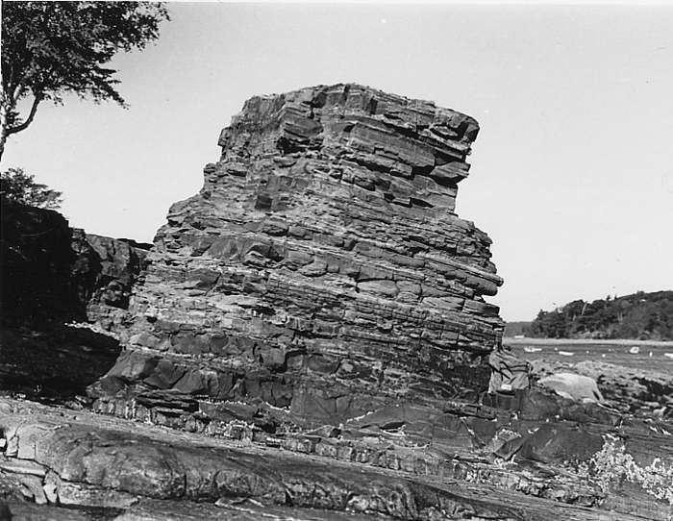
Bar Harbor Formation
Notes:
That the Bar Harbor Formation is younger than the metamorphism of the Ellsworth Schist is evident from the fact that the marine strata of the Bar Harbor Formation is largely unaffected by metamorphism and is only slightly tilted. The thinly bedded sandstones and siltstones show graded bedding and may represent turbidites …

Slide 26
Bar Harbor Fm.
Notes:
… shed from the Avalon terrane as it uplifted and eroded following the event which metamorphosed the Ellsworth Schist.

Slide 27
Cranberry Island Series
Notes:
A bit younger than the Bar Harbor Conglomerate (or perhaps the same age) is the Cranberry Island Series, which represents a series of volcanic rocks formed from the subduction of the Iapetus sea floor beneath Avalonia.

Slide 28
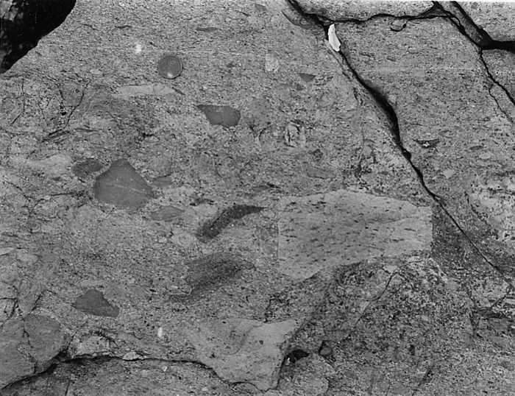
Cranberry Island Series
Notes:
As is typical of volcanoes formed by wet melting due to subduction, the magma contained a violent combination of high-silica and high-water content. The explosivity of these early Devonian composite volcanoes is evidenced by their fragmental (pyroclastic) texture.

Slide 29
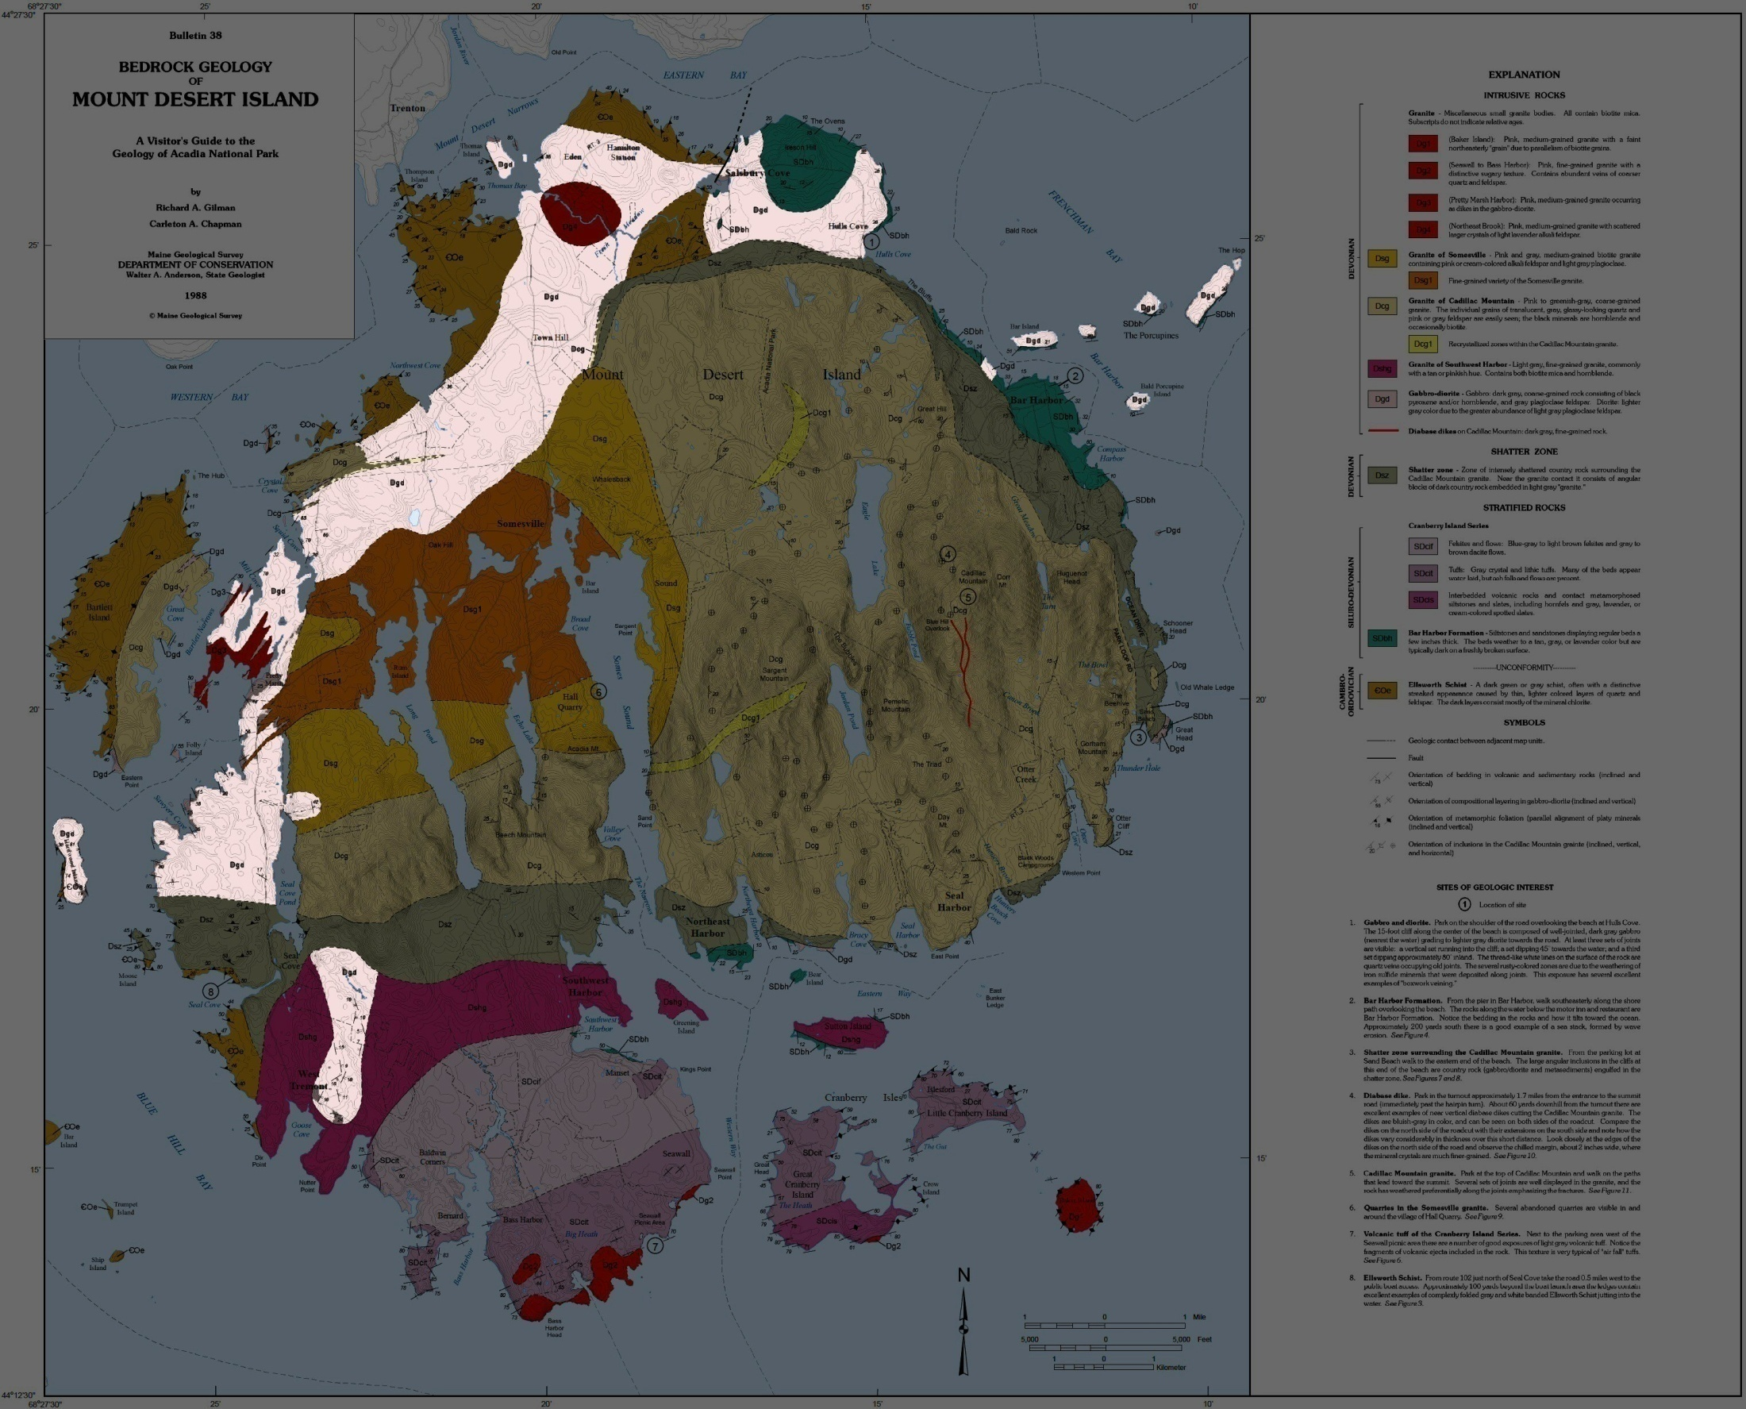
Notes:
During the Middle to Late Devonian the trio of older stratified rocks was intruded by a series of plutonic igneous rocks. Highlighted here is the first of the plutonic intrusions which is a sill-like body comprised of gabbro and diorite.

Slide 30
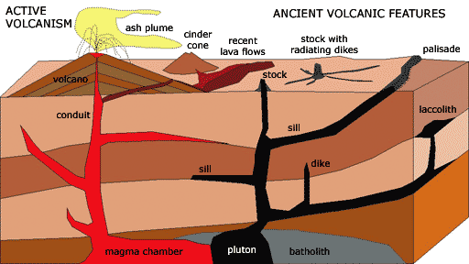
Notes:
Sills are roughly tabular masses of igneous rock that are injected between layers of stratified rocks. They are typically of mafic composition because mafic magma is fluid enough spread out between rock layers. They are also typical of an early phase of plutonic activity, because mafic magmas are hot enough to partially melt the base of the crust where they often pond, thereby forming more felsic magmas that will be emplaced as massive plutons at a later time.

Slide 31
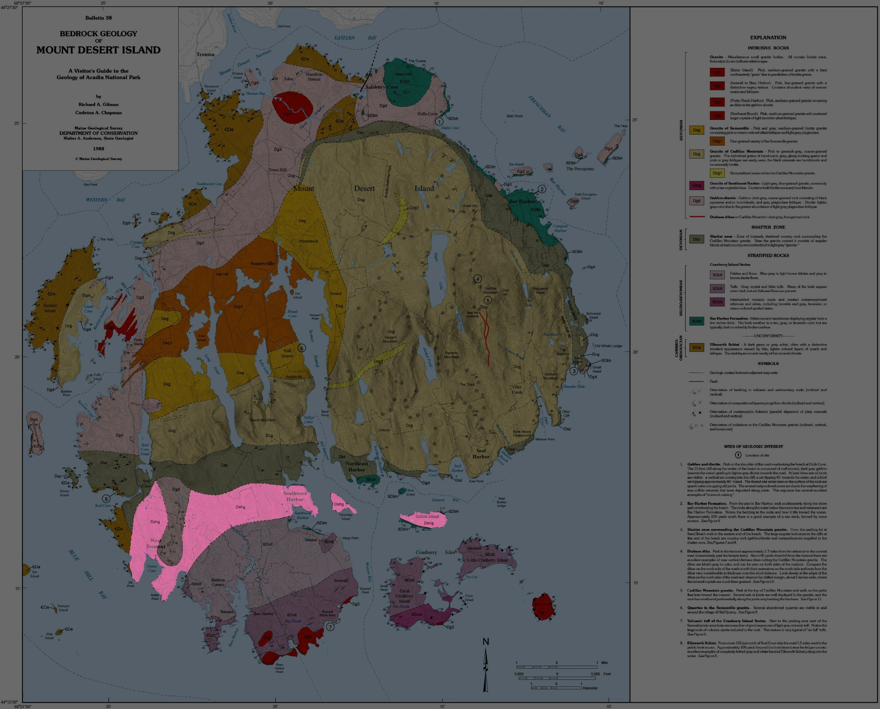
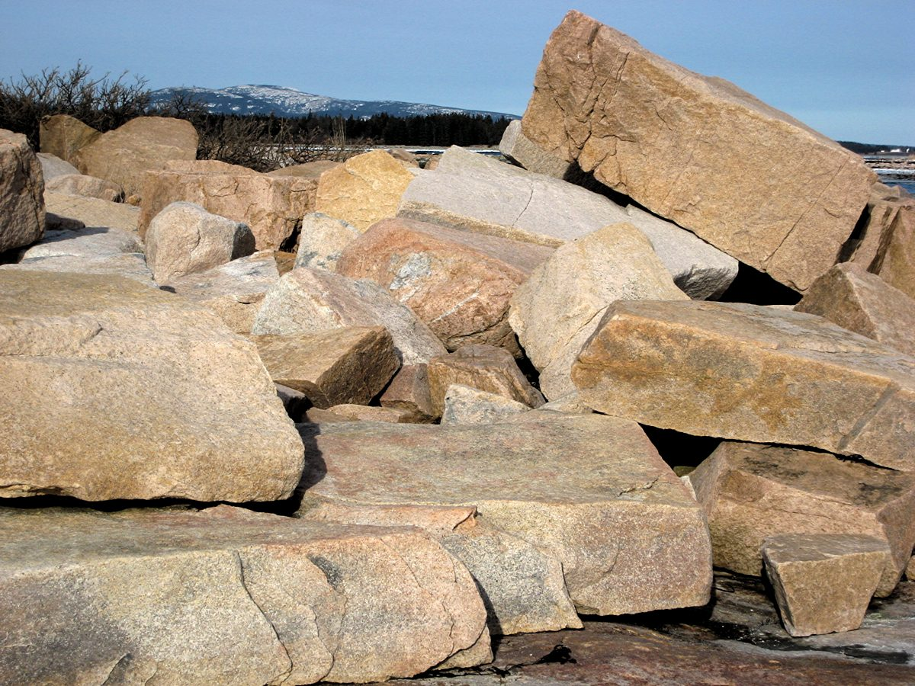
Granite of Southwest Harbor
Notes:
The first of the felsic plutons to be emplaced is represented by the Granite of Southwest Harbor. This granite is fine-grained, which is typical of small plutons that cool more rapidly than large plutons.

Slide 32
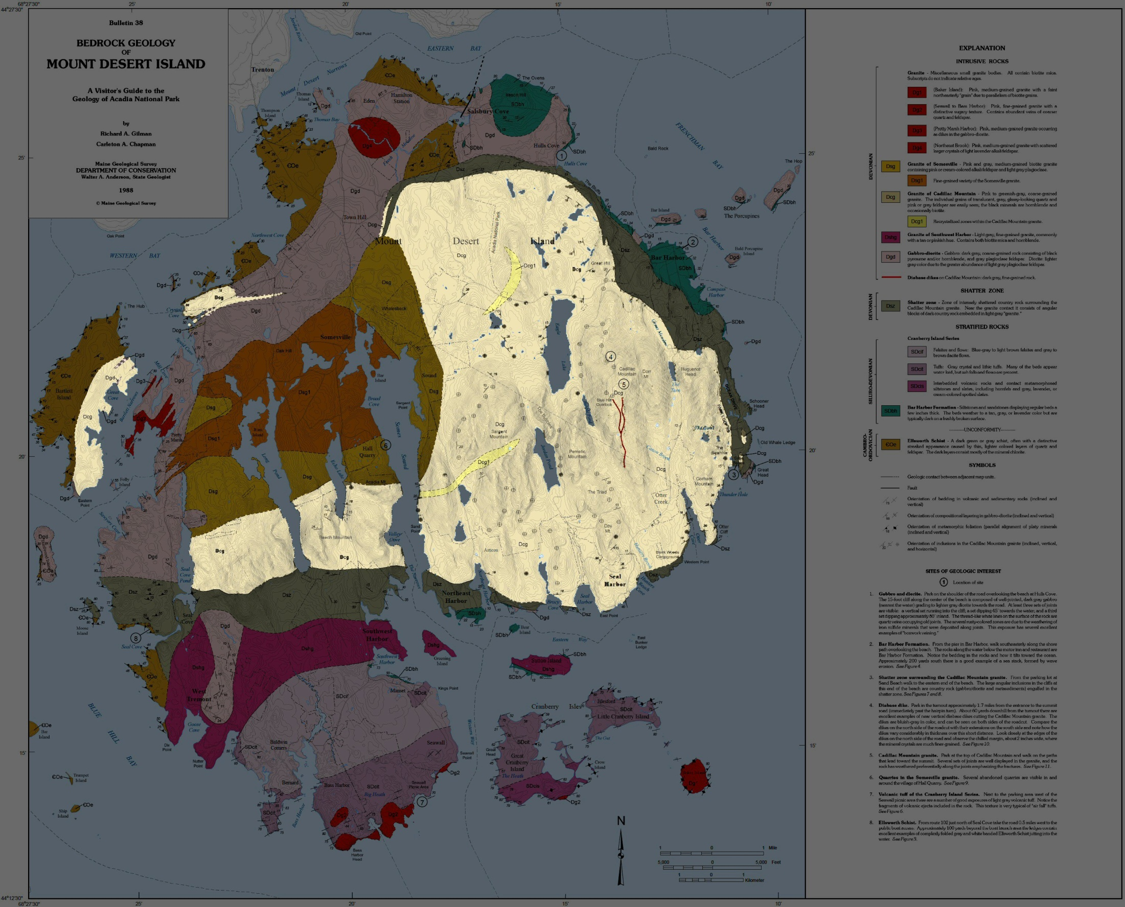
Notes:
The much larger pluton that formed the Granite of Cadillac Mountain cooled more slowly …

Slide 33
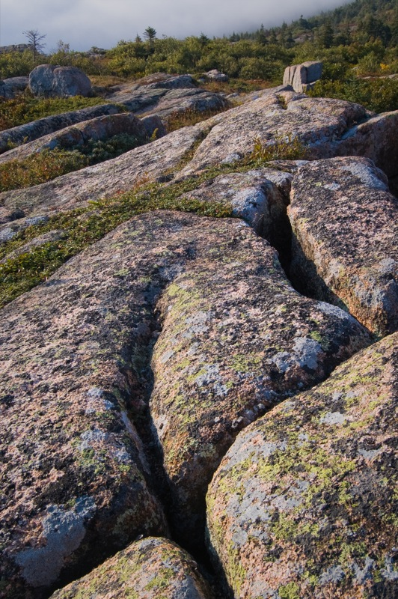
Granite of Cadillac Mountain
Notes:
… and produced a more coarse-grained granite.

Slide 34
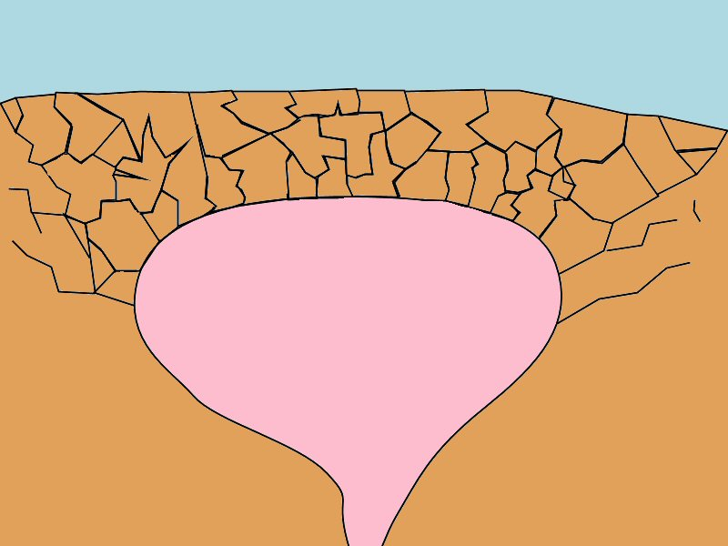
Notes:
The forceful intrusion of this massive pluton severely fractured the country rocks into jagged blocks…

Slide 35
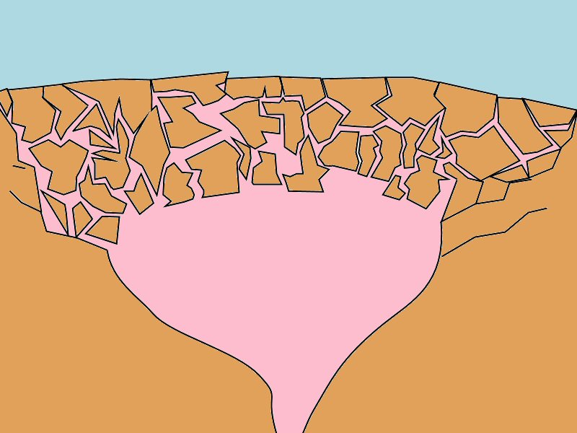
Notes:
… which sank into the magma while the granitic magma worked its way around the blocks toward the surface.

Slide 36
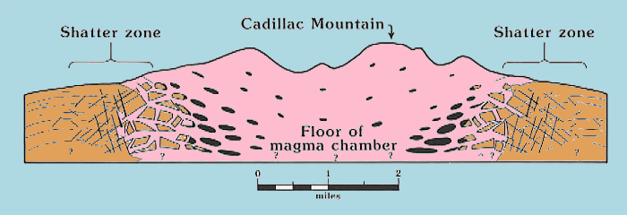
Notes:
The blocks sank, partially melted and accumulated towards the floor of the magma chamber such that the current level of erosion exposes the shatter zone …

Slide 37
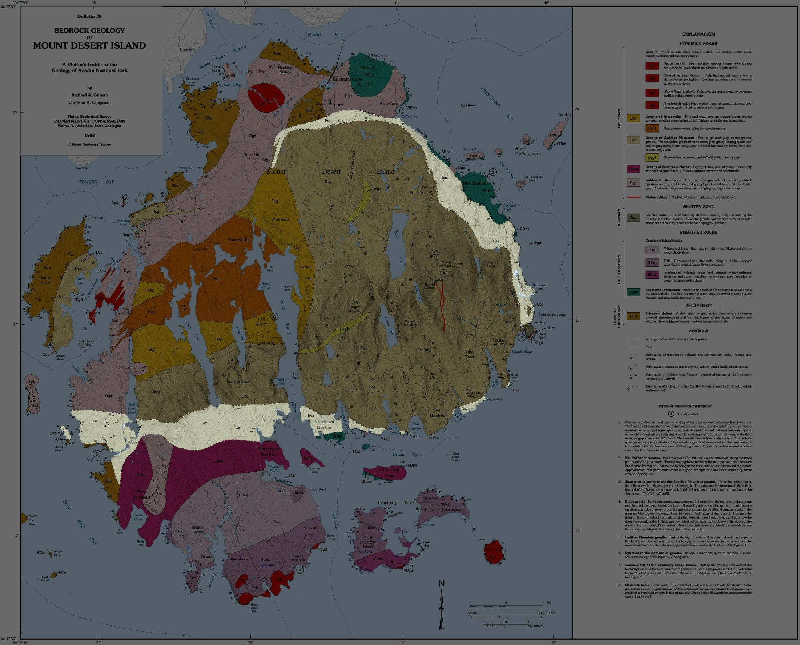
The Shatter Zone
Notes:
… as a ring surrounding the Granite of Cadillac Mountain.

Slide 38
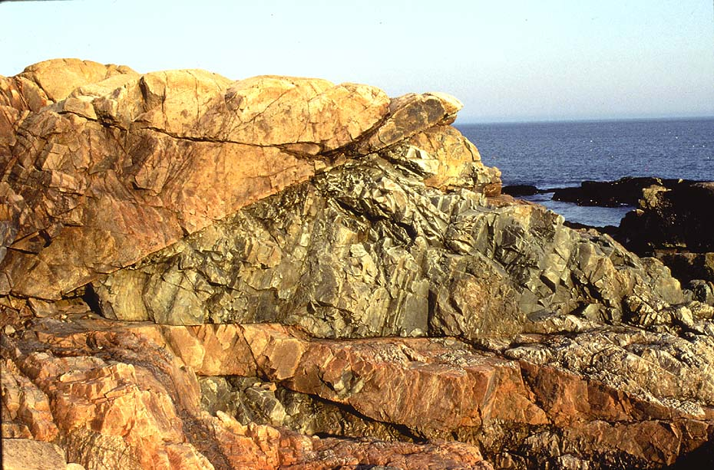
The Shatter Zone
granite
country rock
Notes:
This zone of severely shattered, fractured and brecciated rock is up to a mile or more in width and lies between the coarse grained Granite of Cadillac Mountain and the metamorphosed country rock. Angular blocks of diverse rock types are intruded and surrounded by a matrix of granite.

Slide 39
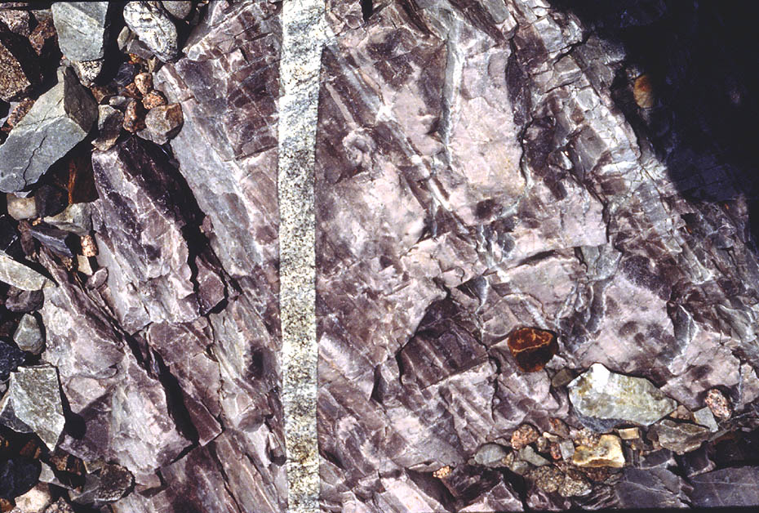
The Shatter Zone
country rock
quartz
Notes:
Mineralization is common in the shatter zone and includes quartz veins, pegmatites and sulfides; however none is of economic value.

Slide 40
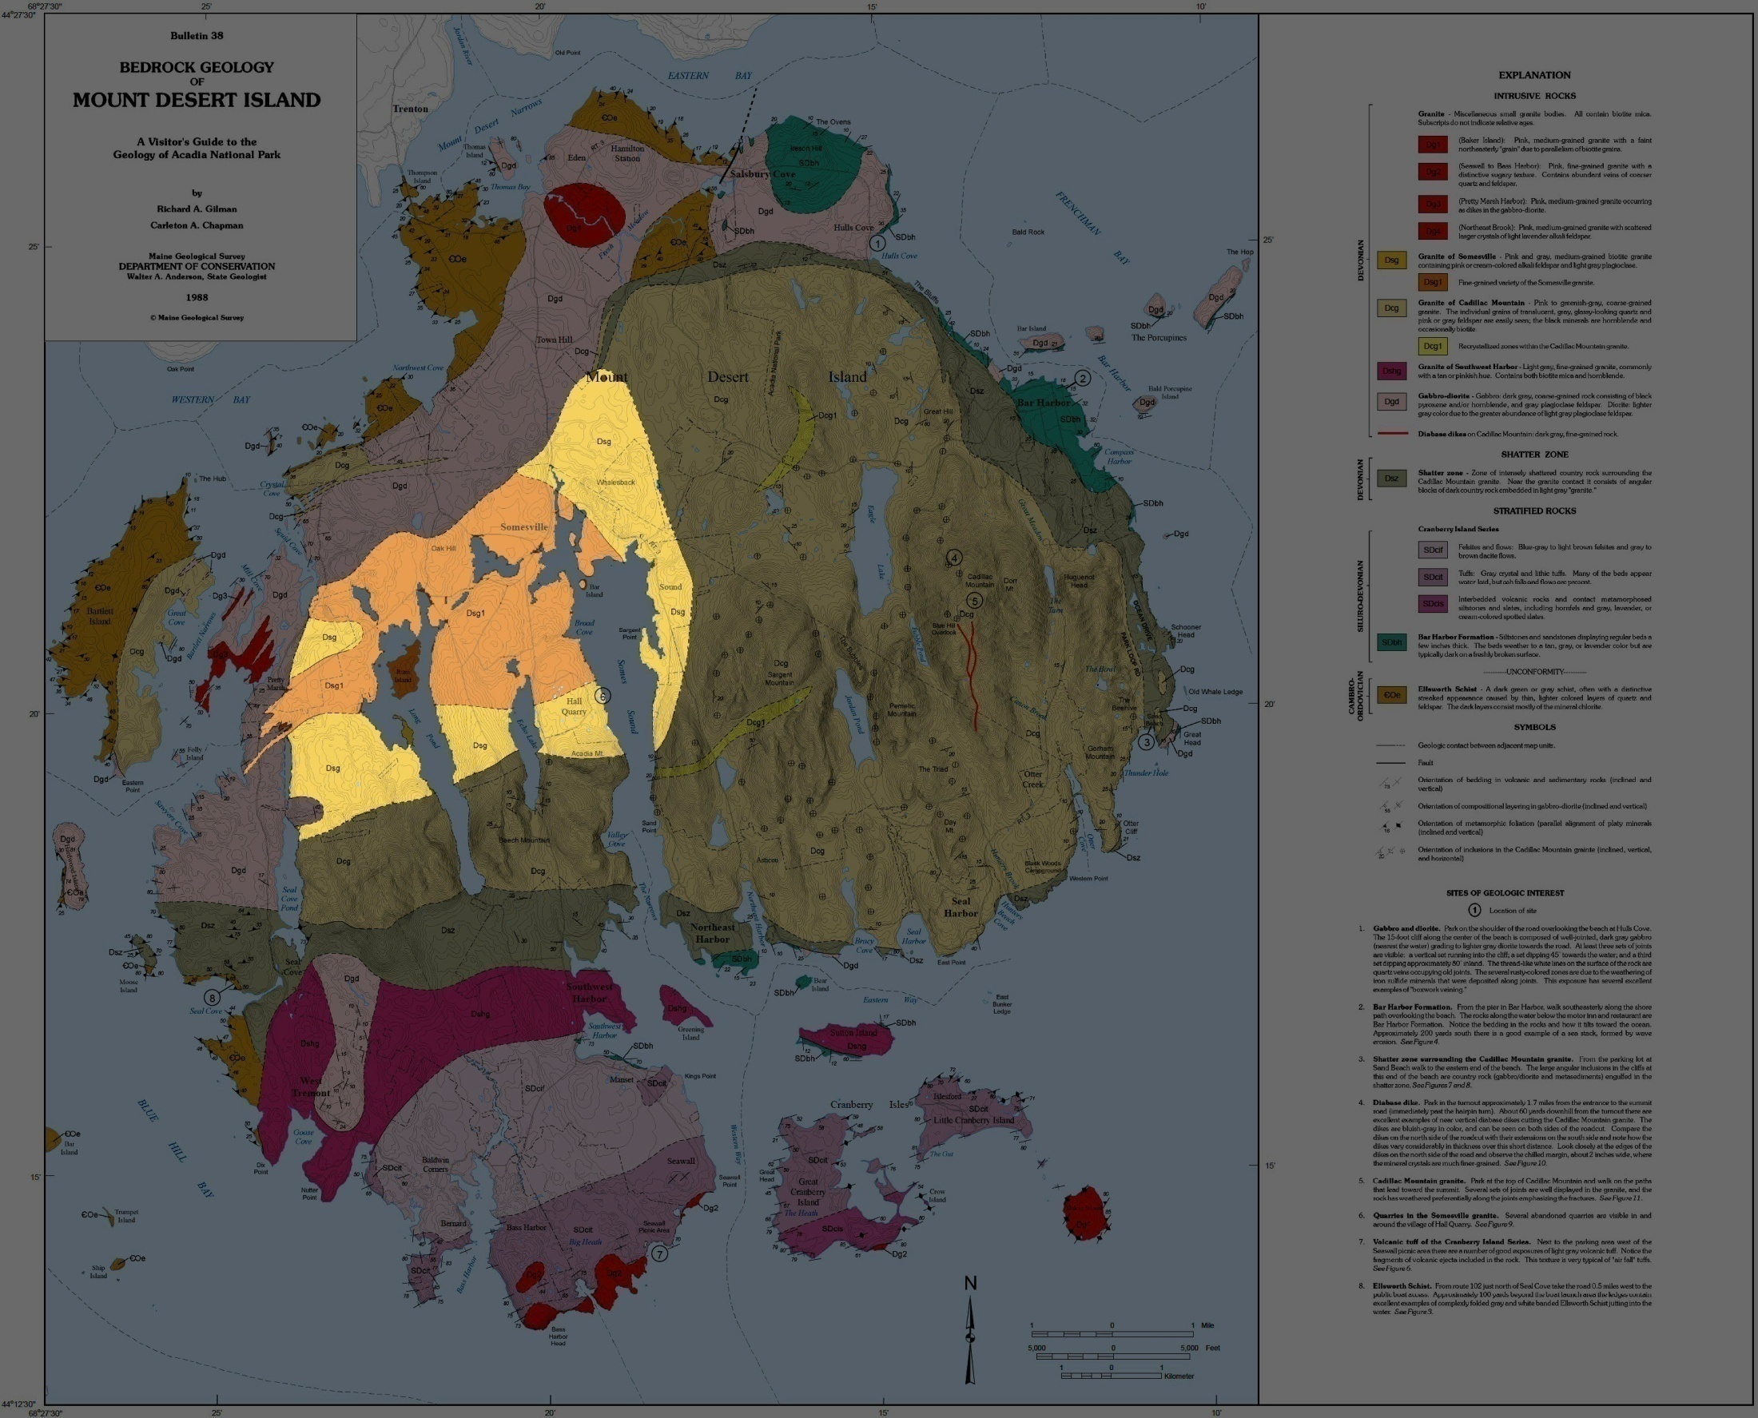
Granite of Somesville
Notes:
The intrusion of the Granite of Cadillac Mountain was followed by the Granite of Somesville and several miscellaneous small granite bodies.

Slide 41
Approaching Acadian Orogeny
Iapetus
Subducted Iapetus
Notes:
The origin of all this plutonic activity is a little uncertain. The subduction of the Iapetus remnant ocean basin seems a likely candidate, …

Slide 42
Acadian Orogeny
Subducted Iapetus
Notes:
… but the plutons here are Middle to Late Devonian - about the same as the Acadian Orogeny. Thus most, if not all, of that subduction should already have ended by the time the granite plutons had crystallized.

Slide 43
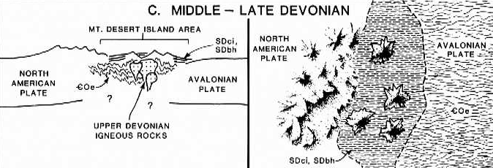
Notes:
One idea is that the collision between Avalonia and North America compressed and piled-up the intervening rocks to the degree that those at the bottom of the pile were buried deep enough to melt. Collision orogeny like this is generally capable of forming only felsic magma, because the source rocks undergo neither decompression nor wet melting which are needed to melt more mafic rocks.

Slide 44
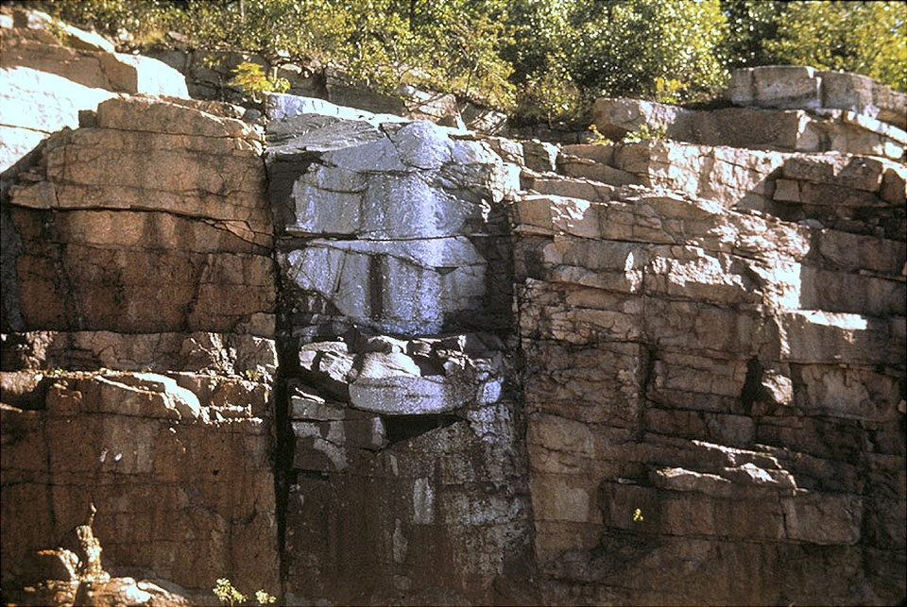
Notes:
Thus I am somewhat uncertain regarding the origin of the numerous, eye-catching mafic dikes …

Slide 45
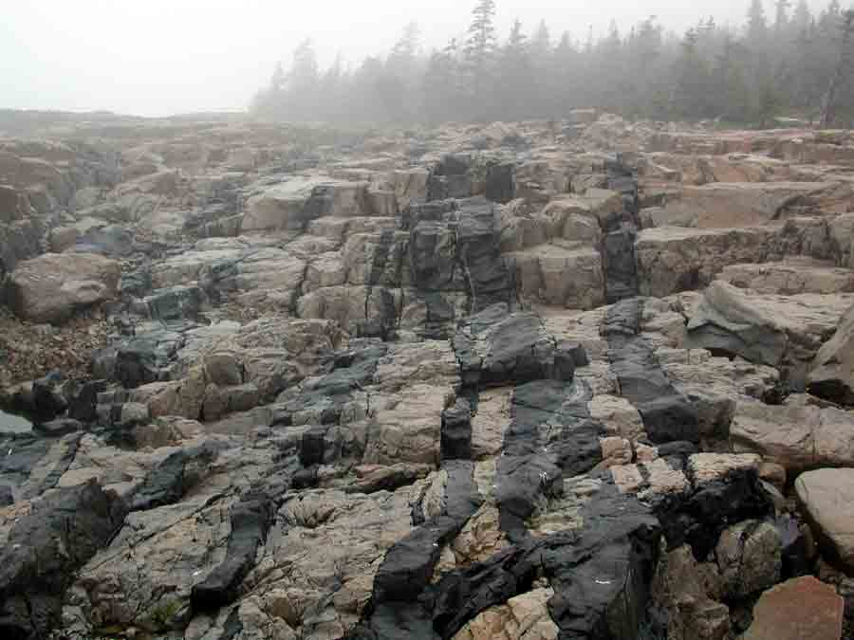
Schoodic Point
Notes:
… that crisscross the felsic plutons. In most places, like here at Schoodic Point, they are obviously younger than the felsic plutonic rocks, but field relationships elsewhere suggest they intruded throughout the period of pluton emplacement. Perhaps they represent the mafic fraction of originally intermediate magmas that fractionated into felsic and mafic components. Alternately, perhaps subduction somehow continued throughout the Acadian. I just don’t know. The dikes are particularly abundant at Schoodic Point…

Slide 46
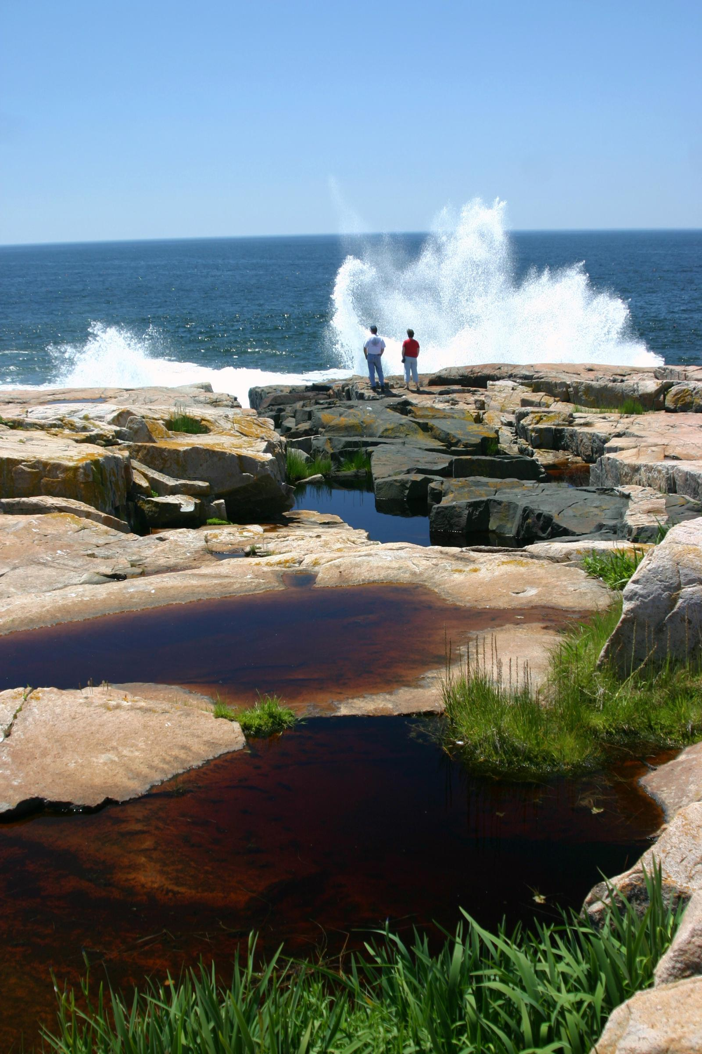
Notes:
… where wave …

Slide 47
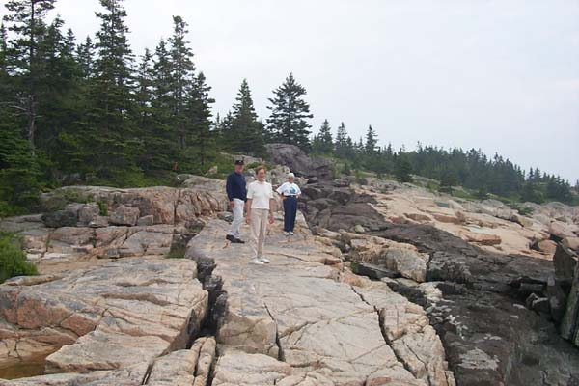
Notes:
… and glacial erosion have left them beautifully exposed.

Slide 48
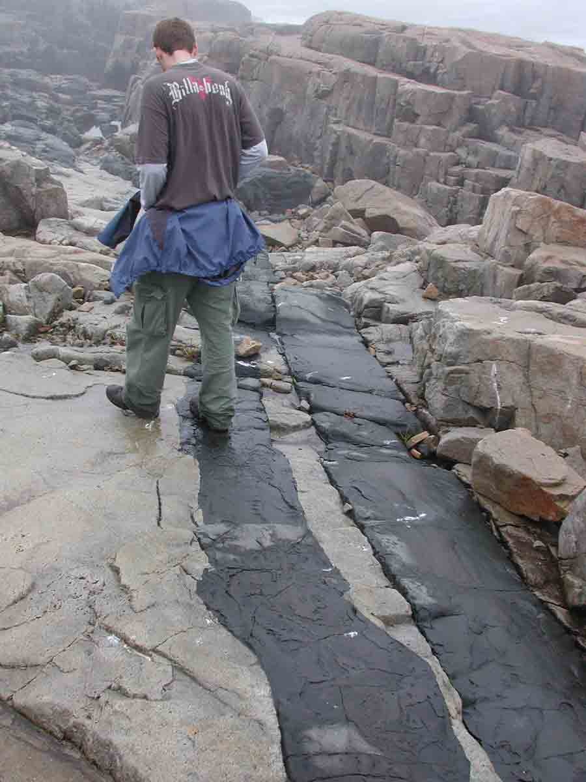
Diabase
Notes:
Most of these dikes are diabase – a mafic igneous rock like gabbro and basalt, but not as coarse-grained as gabbro or as fine-grained as basalt. The relatively small quantities of magma here cool quickly, but not as quickly as lava.

Slide 49
Yah, but I’m to cool to turn around.
Notes:
…

Slide 50
Notes:
Eventually all magmatic activity will come to an end as the Avalon Terrane (Avalonia) stops being over-thrust onto the North American continent.

Slide 51
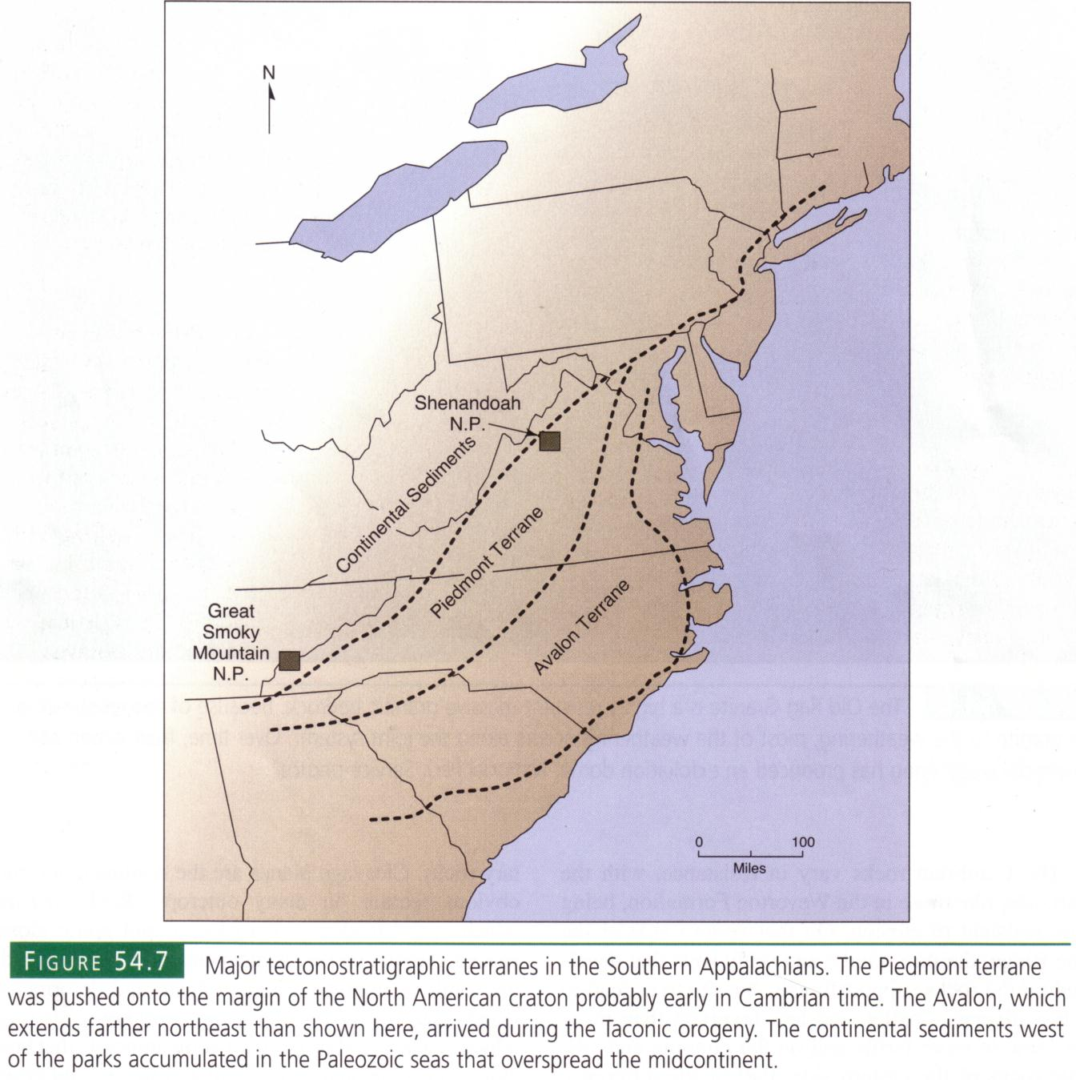
Buried Avalon Terrane
Notes:
It is important to note that the Acadian Orogeny affected the central and southern Appalachians as well as in New England. Even though the Avalon Terrane is lies buried beneath the sediments of the present continental margin of Virginia and the Carolinas, …

Slide 52
Yet another foreland basin
Notes:
… surface evidence of the Acadian does exist. That’s because the Acadian (like the Taconic) created foreland basins which filled with sediments that record the uplift and erosion of the Acadian Mountains. The largest of these is the Catskill Foreland Basin which was connected to the Kaskaskia epicontinental sea …

Slide 53
Notes:
… which covered most of North America during the Middle to Late Devonian.

Slide 54
Notes:
Central Appalachia lay on the equator at the time which meant that the Acadian Mountains formed a rain shadow in the trade wind belt…

Slide 55
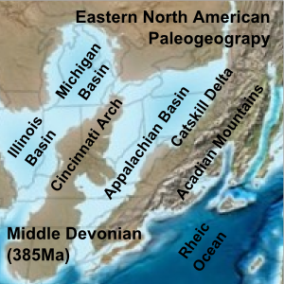
Notes:
… creating arid conditions in the foreland basins (and others) which lay to the west. Evaporite deposition was common, …

Slide 56
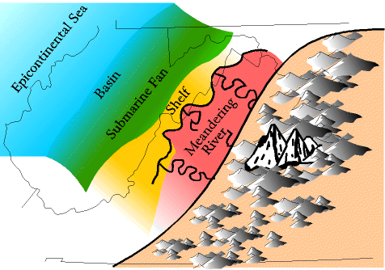
Notes:
… but the thickest sediment sequences where formed by clastic wedges produced by the erosion of the Acadian Mountains.

Slide 57
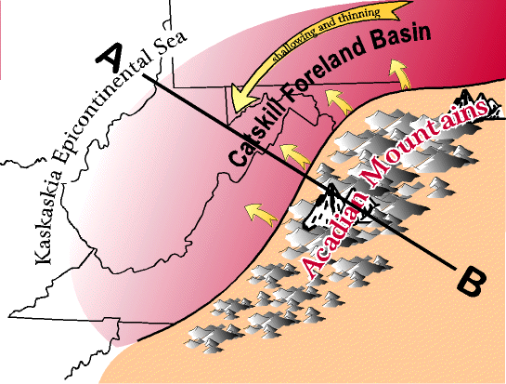
Notes:
In the Mid-Atlantic region the Acadian orogeny (like the Taconic) took place in two impacts, one in eastern Pennsylvania, New Jersey and New York (producing the Catskill Foreland Basin) …

Slide 58
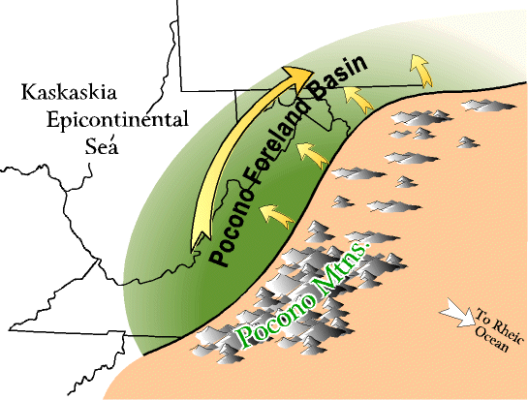
Notes:
… and the second in southern Virginia (producing the Pocono Foreland Basin). Each of these basins filled with a clastic wedge.

